Slide 1
MINI PROJECT 1
POWER LIFTING
BY
D ASWIN

Slide 2
FILE FORMAT’S
CSV Data Format
The Powerlifting data is presented in a CSV format. The format is straightforward: double-quotes.
Column Definitions
Sex (Mandatory): The lifter's sex category. Values are:
M for Male
F for Female

Slide 3
QUESTIONS
1. Top 10 states for Men.
2. Top 10 states for Women.
3. Plot pie chart and bar chart for Men Top 21-30 states (inclusive).
(Plot one with Matplotlib and one with Seaborn)
4. Plot pie chart and bar chart for Women Top 21-30 states (inclusive).
(Plot one with Matplotlib and one with Seaborn)
5. Top 10 states for Men in year 2021
(Hint: Use Custom Function)
6. Top 10 states for Women in year 2021
(Hint: Use Custom Function)
7. Stack bar chart for men vs women X axis -> 18-30 | 31-40 | 41-50 | 51-60
(Hint: Use Custom Function or pandas pd.cut)
8. Pie chart for men w.r.t age group (18-30 | 31-40 | 41-50 | 51-60) 9. Pie chart for women w.r.t age group (18-30 | 31-40 | 41-50 | 51-60) 10. Histogram for men by age (use Age for binning purpose)
11. Histogram for women by age (use Age for binning purpose)

Slide 4
TO INITIATE CODE’S
import pandas as pd
from tabulate import tabulate
import traceback
import numpy as np
import matplotlib.pyplot as plt
from requests import get
import requests
import os

Slide 5
PANDAS :
pandas provides rich data structures and functions designed to make working with structured data fast, easy, and expressive. It is, as you will see, one of the critical in gredients enabling Python to be a powerful and productive data analysis environment. The primary object in pandas that will be used in this book is the DataFrame

Slide 6
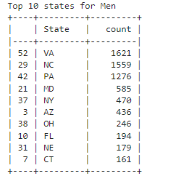
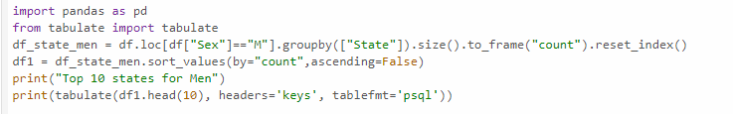
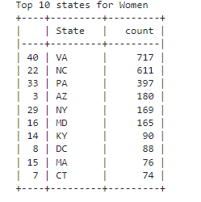
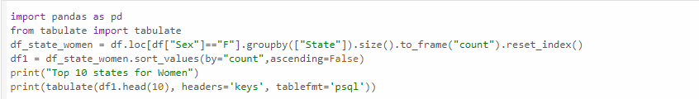
QUESTION : TOP 10 STAT FOR MEN & WOMEN
OUTPUT :
Groupby :
In pandas,groupby is a method used to group data in a DataFrame based on one or more columns. After grouping, you can perform aggregate functions, transformations, or filtering on each group.
The groupby method groups data based on specified columns,it groups the filtered DataFrame (Male or Female) by state and counts the number of males or females in each state.
CODE :

Slide 7
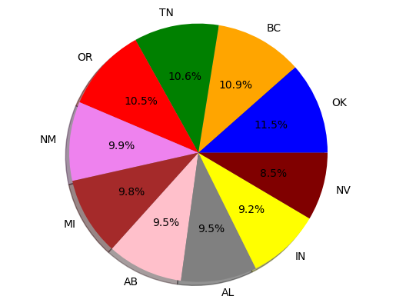
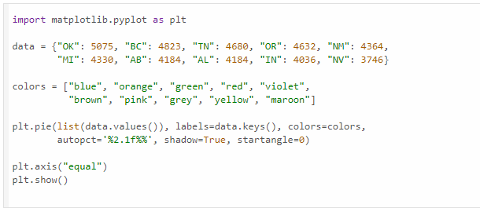
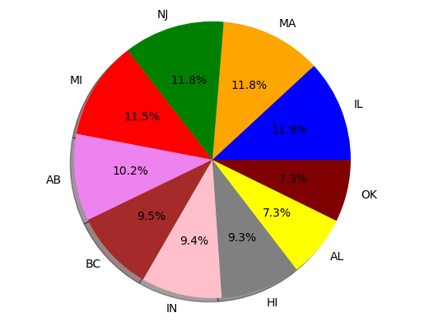
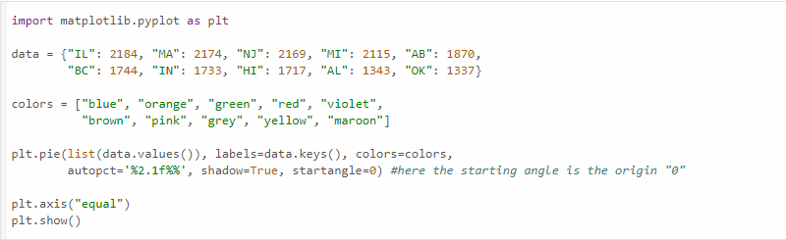
QUESTION : PLOT PIE CHART AND BAR CHART FOR MEN & WOMEN TOP 21-30 STATES
MATPLOT :
Matplotlib is a popular Python library for making charts and graphs. It’s great for creating high-quality plots that you can use in publications. It works well with IPython, offering an interactive environment where you can easily explore and visualize your data. You can also interact with the plots, like zooming in or panning around, using tools in the plot window.
To using a code(matplotlib.pyplot) when creates a pie chart. It visualizes the data from a dictionary with different colors for each segment, shows percentage values on the chart, and ensures that the pie is drawn as a circle with plt.axis(“equal”).
OUTPUT :
CODE :

Slide 8
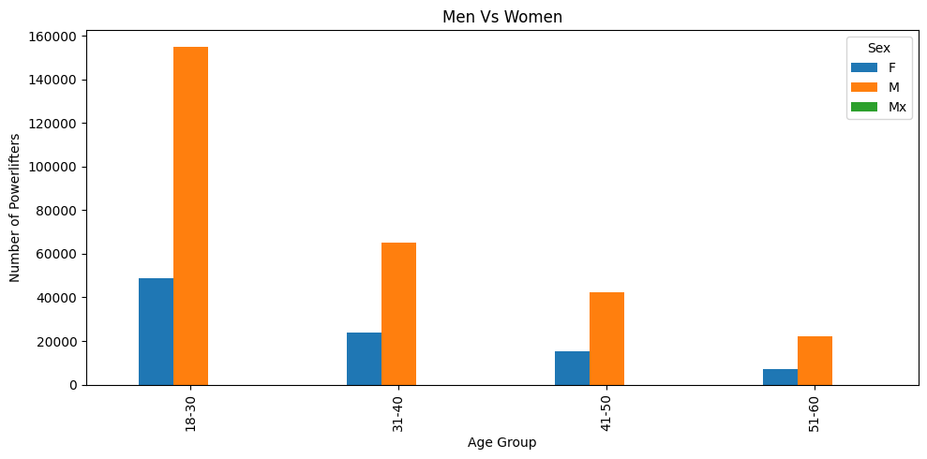
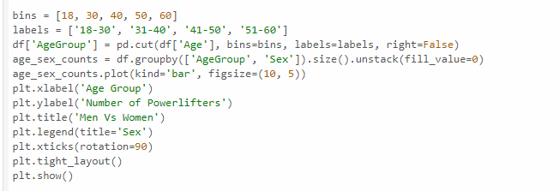
QUESTION :STACK BAR CHART FOR MEN VS WOMEN X AXIS -> 18-30 | 31-40 | 41-50 | 51-60
OUTPUT :
LABEL :
The labels parameter in plt.pie assigns names to each segment of the pie chart, using the keys from the data dictionary to label each slice.
Defines the names for each age group. These labels are used to identify the age ranges in the resulting age group column, making the chart easier to understand.
Pd.cut() :
It uses `pd.cut()` to categorize ages into defined bins, then groups and counts the data by age group and sex. The `plot(kind='bar')` function visualizes these counts, with custom labels, a title, and rotated x-axis labels for clarity.
CODE :

Slide 9
THANK YOU

